Slide 1

IAC with Terraform and AWS Cloud
Author: Shahbaz Rahmat Kareem
Senior Consultant in Infrastructure and Cloud Services

Slide 2
Topics
IAC (Infrastructure as a Code)
CHALLENGES OF CLOUD INFRASTRUCTURE PROVISIONING
Why I chose Terraform
Terraform scripting
Best practices
Terraform code automation

Slide 3
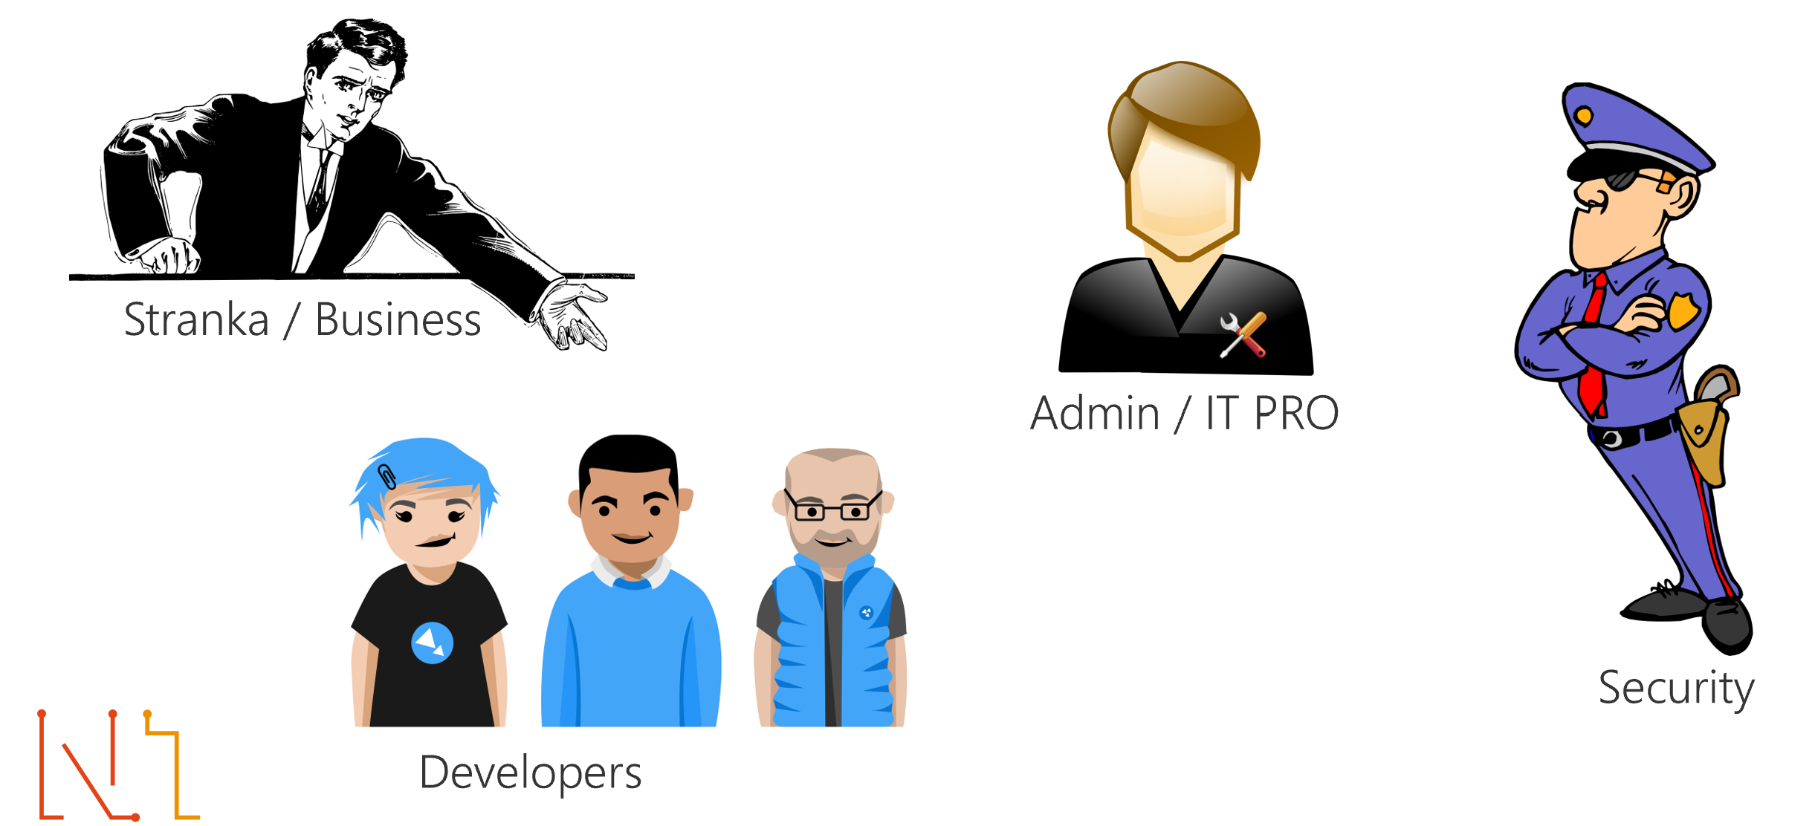
CHALLENGES OF CLOUD INFRASTRUCTURE PROVISIONING

Slide 4
CHALLENGES OF CLOUD INFRASTRUCTURE PROVISIONING
People
Central IT struggles with manual workflows that are slow and error-prone.
Developers want to improve application delivery, but are stymied by manual provisioning workflows.
Process
Developers still request infrastructure via ticketing which is slow.
Policy enforcement is manual or non-existent which impacts productivity and risk.
Tools
Teams use multiple provisioning and management tools which decreases productivity.
Infrastructure automation lacks automation that is scalable, consistent, and reusable.

Slide 5
CHALLENGES OF CLOUD INFRASTRUCTURE PROVISIONING
Business impact using Terraform
Increased Productivity
Reduce time spent using manual workflows to create, share, manage, and provision cloud infrastructure.
Reduced Risk
Improve security posture, reduce non-compliance, and maintain operational consistency for cloud infrastructure.
Reduced Cost
Reduce unnecessary cloud spend by up to 40% from idle, orphaned, and over-sized cloud resources.

Slide 6
Infrastructure as Code
DevSecOps
DevOps is a set of software development practices that combines software development (Dev), information technology security (Sec) and information technology operations (Ops) to shorten the systems development life cycle while delivering features, fixes, and updates frequently in close alignment with business objectives.
Infrastructure as code (IaC) is the process of managing and provisioning computer data centers through machine-readable definition files, rather than physical hardware configuration or interactive configuration tools.
Infrastructure as code (IaC)

Slide 7
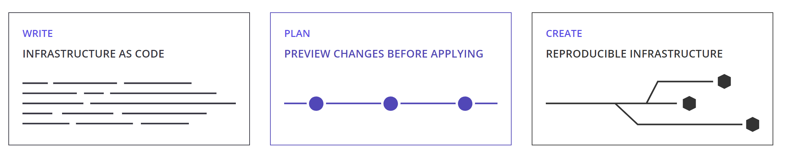
Why I Chose Terraform

Slide 8

Why I Chose Terraform

Slide 9
Why I Chose Terraform
Terraform Providers:
AWS, Azure, Google Cloud Platform, OpenStack, Kubernetes, Docker, ACME, Alicloud, Archive, Arukas,, Azure Active Directory, Azure Stack, Bitbucket, Brightbox, CenturyLinkCloud, Chef, Circonus, Cisco ASA, Cloudflare, CloudScale.ch, CloudStack, Cobbler, Consul, Datadog, DigitalOcean, DNS, DNSimple, DNSMadeEasy,, Dyn, External, F5 BIG-IP, Fastly, FlexibleEngine, FortiOS, GitHub, Gitlab,, Grafana, Gridscale, Hedvig, Helm, Heroku, Hetzner Cloud, HTTP, HuaweiCloud, Icinga2,Ignition, InfluxDB, JDCloud,, Librato, Linode, Local, Logentries, LogicMonitor, Mailgun, MySQL, Naver Cloud, Netlify, New Relic,Nomad, NS1, Null, Nutanix, 1&1, OpenTelekomCloud, OpsGenie, Oracle Cloud Infrastructure, Oracle Cloud Platform, Oracle Public Cloud, OVH, Packet, PagerDuty, Palo Alto Networks, PostgreSQL, PowerDNS, ProfitBricks, RabbitMQ, Rancher, Rancher2, Random, RightScale, Rundeck, RunScope, Scaleway, Selectel, Skytap, SoftLayer, Spotinst, StatusCake, TelefonicaOpenCloud, Template, TencentCloud, TLS, Triton, UCloud, UltraDNS, Vault, VMware NSX-T, VMware vCloud Director, VMware vRA7, VMware vSphere, Yandex

Slide 10
Terraform scripting
provider "aws" {
region = var.region
}
terraform {
backend "s3" {}
}
module "network" {
source = "./modules/vpc"
vpc_cidr = var.vpc_cidr
tenancy = var.tenancy
env = var.env
}

Slide 11
Best Practice
Structuring
Naming Convention
Latest Version of Terraform and providers
Lock State File
Run terraform command with var-file
Enable version control on terraform state files bucket
Manage backend for tfstate files
Manage multiple Terraform modules
Turn on debug when you need do troubleshooting

Slide 12
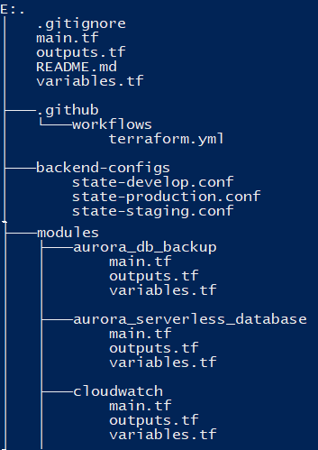
Structure

Slide 13
Naming Convention
Naming conventions are used in Terraform to make things easily understandable.
For example, let’s say you want to make three different workspaces for different environments in a project. So, rather than naming then as env1, en2, env3, you should call them as a dev, stage, prod. From the name itself, it becomes pretty clear that there are three different workspaces for each environment.
Similar conventions for resources, variables, modules, etc. also should be followed. The resource name in Terraform should start with a provider name followed by an underscore and other details.
For example, the resource name for creating a terraform object for a route table in AWS would be aws_route_table.

Slide 14
Latest Version of Terraform and providers
Terraform development community is very active, and the release of new functionalities happens frequently. It is recommended to stay on the latest version of Terraform as in when a new major release happens. You can easily upgrade to the latest version.
If you skip multiple major releases, upgrading will become very complex.

Slide 15
Lock State File
There can be multiple scenarios where more than one developer tries to run the terraform configuration at the same time. This can lead to the corruption of the terraform state file or even data loss. The locking mechanism helps to prevent such scenarios. It makes sure that at a time, only one person is running the terraform configurations, and there is no conflict.
Here is an example of locking the state file, which is at a remote location using DynamoDB.

Slide 16
Run terraform command with var-file
In terraform, you can create a file with extension <em>.</em>tfvars and pass this file to terraform apply command using -var-file flag. This helps you in passing those variables which you don’t want to put in the terraform configuration code.
It is always suggested to pass variables for a password, secret key, etc. locally through -var-file rather than saving it inside terraform configurations or on a remote location version control system.

Slide 17
Enable version control on terraform state files bucket
Always set backend to s3 and enable version control on this bucket.
s3-backend to create s3 bucket and dynamodb table to use as terraform backend.

Slide 18
Manage backend for tfstate files
Terraform doesn't support Interpolated variables in terraform backend config, normally you write a seperate script to define s3 backend bucket name for different environments, but I recommend to hard code it directly as below. This way is called as partial configuration
Add below code in terraform configuration files.
$ cat main.tf
terraform {
backend "s3" {
encrypt = true
}
}
Define backend variables for particular environment
$ cat config/backend-dev.conf
bucket = "<account_id>-terraform-states"
key = "development/service-name.tfstate"
encrypt = true
region = "ap-southeast-2"
#dynamodb_table = "terraform-lock"

Slide 19
Manage multiple Terraform modules
Manage terraform resource with shared modules, this will save a lot of coding time. No need re-invent the wheel!
You can start from below links:
Terraform module usage
Terraform Module Registry
Terraform aws modules
Up to Terraform 0.12, Terraform modules didn't support count parameter.
From Terraform 0.13 on this feature is already available for your pleasure!

Slide 20
Turn on debug when you need do troubleshooting
TF_LOG=DEBUG terraform <command>
# or if you run with terragrunt
TF_LOG=DEBUG terragrunt <command>

Slide 21
Best Practice
Shared storage for state files: To be able to use Terraform to update your infrastructure, each of your team members needs access to the same Terraform state files. That means you need to store those files in a shared location.
Locking state files: As soon as data is shared, you run into a new problem: locking. Without locking, if two team members are running Terraform at the same time, you may run into race conditions as multiple Terraform processes make concurrent updates to the state files, leading to conflicts, data loss, and state file corruption.
Isolating state files: When making changes to your infrastructure, it’s a best practice to isolate different environments. For example, when making a change in the staging environment, you want to be sure that you’re not going to accidentally break production. But how can you isolate your changes if all of your infrastructure is defined in the same Terraform state file?

Slide 22
Terraform code automation
# Initialize a new Terraform
- name: Terraform Init
run: terraform init -backend-config=backend-configs/state-${{variable_name}}.conf #terraform init
env:
AWS_ACCESS_KEY_ID: ${{ secrets.AWS_ACCESS_KEY_ID }}
AWS_SECRET_ACCESS_KEY: ${{ secrets.AWS_SECRET_ACCESS_KEY }}
# Generates an execution plan for Terraform
- name: Terraform Plan
run: terraform plan -var-file=terrafrom-tfvars/${{variable_name}}.tfvars
env:
AWS_ACCESS_KEY_ID: ${{ secrets.AWS_ACCESS_KEY_ID }}
AWS_SECRET_ACCESS_KEY: ${{ secrets.AWS_SECRET_ACCESS_KEY }}

Slide 23


